Slide 1

Building Shiny Web Apps with Typescript and Angular
Dustin Ewers
Consultant @ Centare
Demos & Slides: https://github.com/DustinEwers/shiny-angular-demos
Website: www.dustinewers.com
Twitter: @dustinjewers
Notes:
Slide background from: www.subtlepatterns.com

Slide 2
Roadmap
History
Basics
Demos

Slide 3
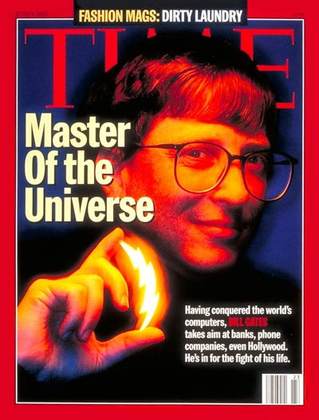



1995
Notes:
http://www.vogue.com/article/pop-culture-1995
1995 was a big year…
Windows 95 – Gates = Dark Lord of the Sith
Toy Story – First Computer Animated Movie
Amazon.com – First Book
Macarena

Slide 4

JavaScript
Sun | Mon | Tues | Wed | Thurs | Fri | Sat
 | 1 | 2 | 3 | 4 | 5 | 6
7 | 8 | 9 | 10 | 11 | 12 | 13
14 | 15 | 16 | 17 | 18 | 19 | 20
21 | 22 | 23 | 24 | 25 | 26 | 27
28 | 29 | 30 | 31
Notes:
Invented by Brendan Eich in 10 freaking days!
-- which is roughly the time it takes to setup a JS toolchain
Netscape browser
Standardized in 1996 by ECMA
Original purpose - To create small bits of web functionality, Remember DHTML
Rest is history!

Slide 5

2005
Notes:
Popularized in apps likes gmail
Allowed for desktop-like web applications
Problem – lots of different browser standards

Slide 6

2006
Notes:
Invented by John Resig
Used on at least 70% of sites on the web | vast majority
Smoothed out the idiosyncrasies of the web

Slide 7

2009
Notes:
Invented in 2009
Server side JS
You’re probably using it…
NPM | Command Line Tools | Cambrian Explosion

Slide 8

2010
Notes:
This is not the angular we’re talking about today
Post –jquery frameworks that provided binding and other applications
MV* frameworks / SPA frameworks

Slide 9
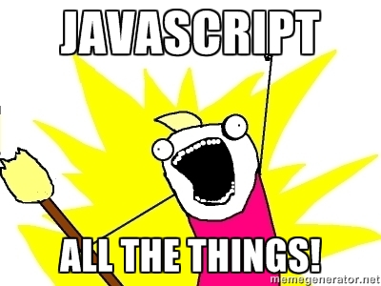
Notes:
Microcontrollers: Johnny-Five
Servers: Node.js
Command line tools: npm, gulp, etc...
Mobile Apps: Cordova, Ionic
Desktop applications: Electron
VR: Renderloop, Three.js
-----
Even Web Applications

Slide 10


Slide 11


Slide 12
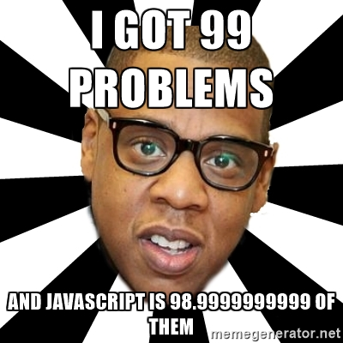
Notes:
Lack of modules
Lousy scope
Lack of a decent type system
Make JavaScript lousy for the large scale apps we want to build things in

Slide 13
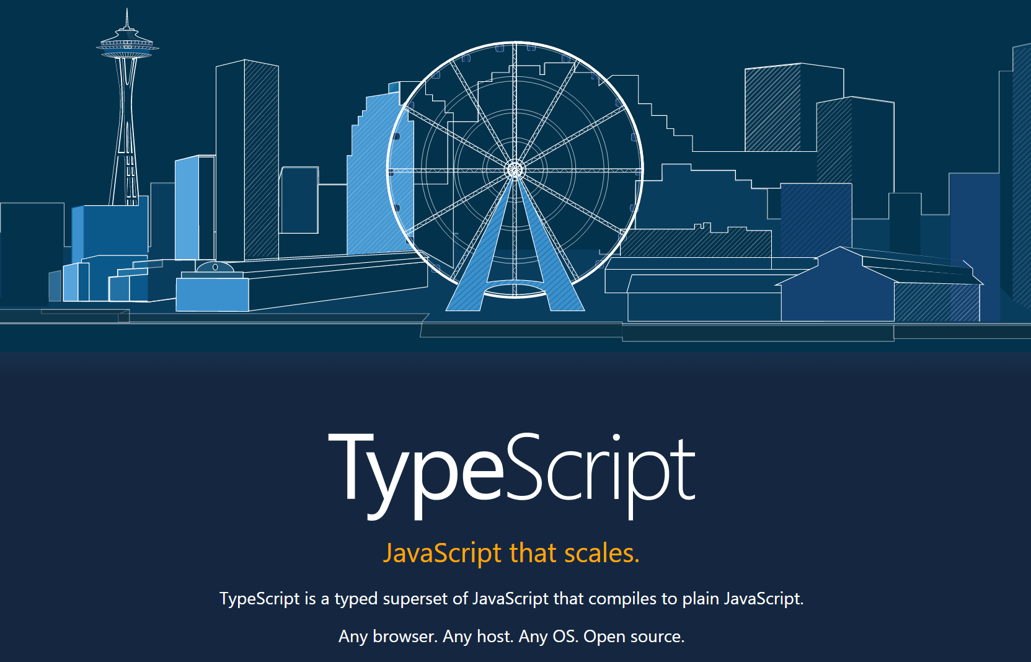
2012
Notes:
TypeScript solves these problems
Invented by Microsoft
Released in 2012 (after two years, not 10 days)

Slide 14
Why Typescript?
You already know it
Future JS Today
Static Types
Notes:
Typescript tracks modern JS, future JS, and adds static types
Modern JS:
As good as the other top line transpilers
Classes, modules, etc…
Future JS:
Tracks new features from newer versions of JS
Static types:
Reduce errors, allow for greater tooling

Slide 15
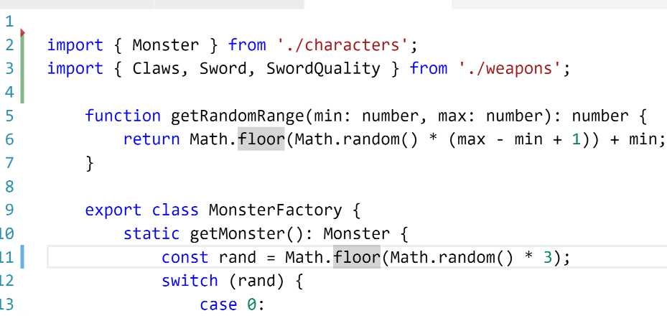
Modules

Slide 16
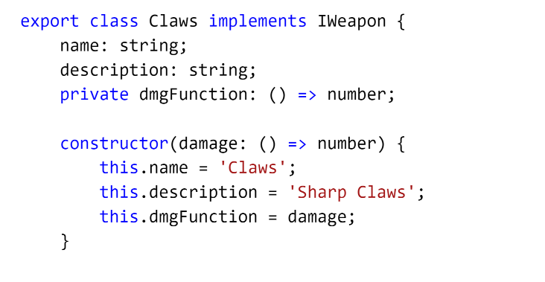
Classes

Slide 17
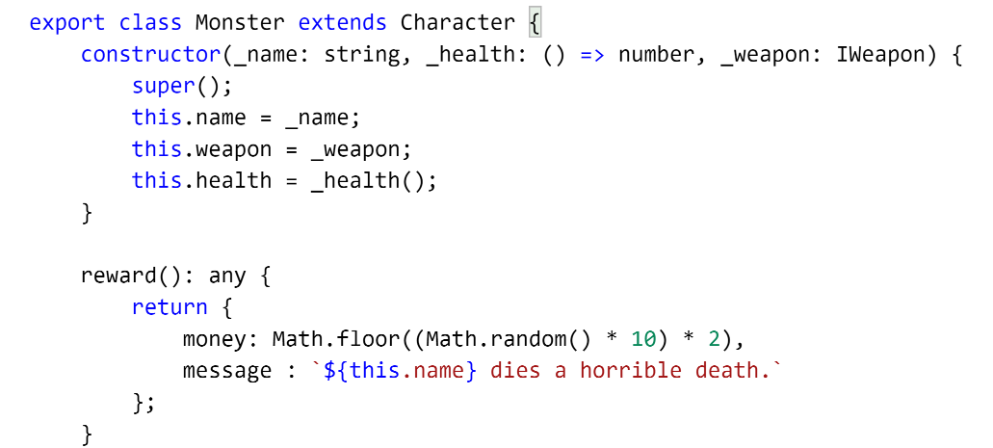
Syntactic Sugar

Slide 18

2016
Angular
(not Angular 2)
Notes:
Angular (Angular 2)
Angular JS is to Angular like Java is to JavaScript
Released in 2016
Build by Google
Totally different than Angular JS (Angular 1)

Slide 19


Slide 20
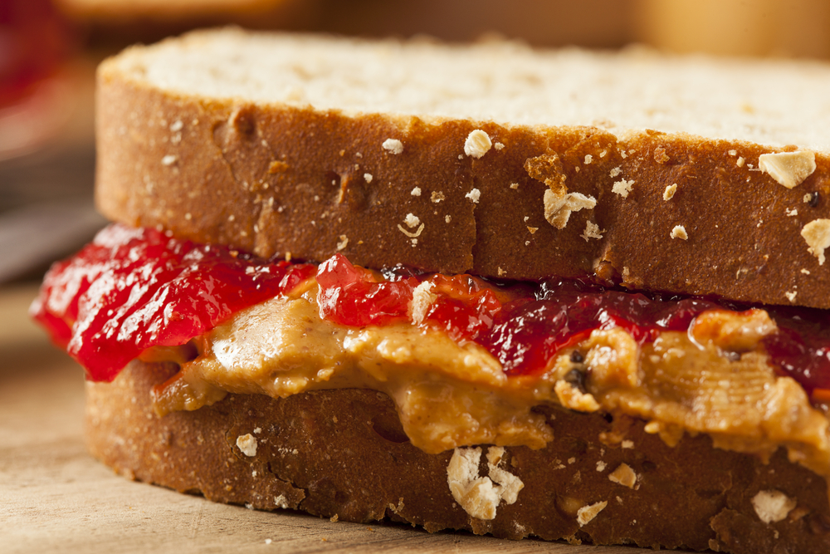
Notes:
What does Angular have to do with Typescript?
Angular and Typescript go together like PB&J

Slide 21
Why Angular?
Works Everywhere
Modular Code
Excellent Performance
Notes:
https://angular.io/features.html
Can Build Desktop (Electron), Mobile (Ionic), and Web Apps
Great Visual Studio Support
Among the quickest client side framework

Slide 22
Alternatives?
React
Ember
Others
Notes:
React is a framework, but it’s more of a legos approach than Angular’s kitchen sink approach
Angular copied a lot of concepts in React
Lots of tool choices, so easy to get into JS fatigue
Ember
Seems to be more popular in the Ruby community
Very opinionated
Others
There’s a new flavor every week. Don’t bother unless it hits critical mass or provides something new
Vue.js, Meteor, Sails, etc…

Slide 23
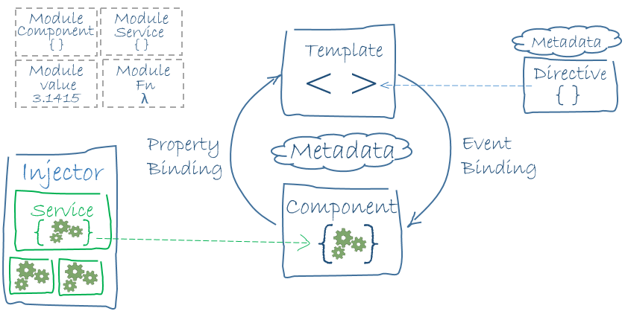
Notes:
https://angular.io/docs/ts/latest/guide/architecture.html
https://angular.io/docs/ts/latest/guide/cheatsheet.html
Angular is an HTML Compiler -> You bind special html and JS together.
At the Core is Components – which are bound to Templates
Services provide cross cutting functionality
Directives and Pipes - provide some additional functionality to templates

Slide 24
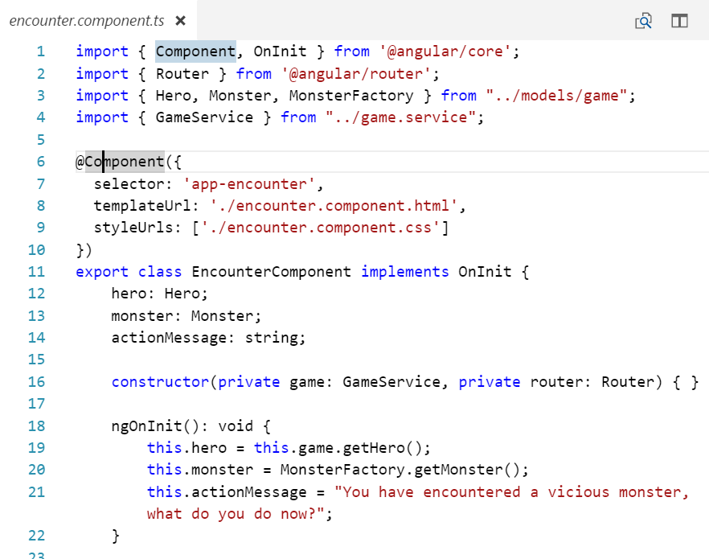
Notes:
Components – encapsulates UI functionality
- Decorators
Lifecycle events (OnInit)
Css/sass / html template links

Slide 25
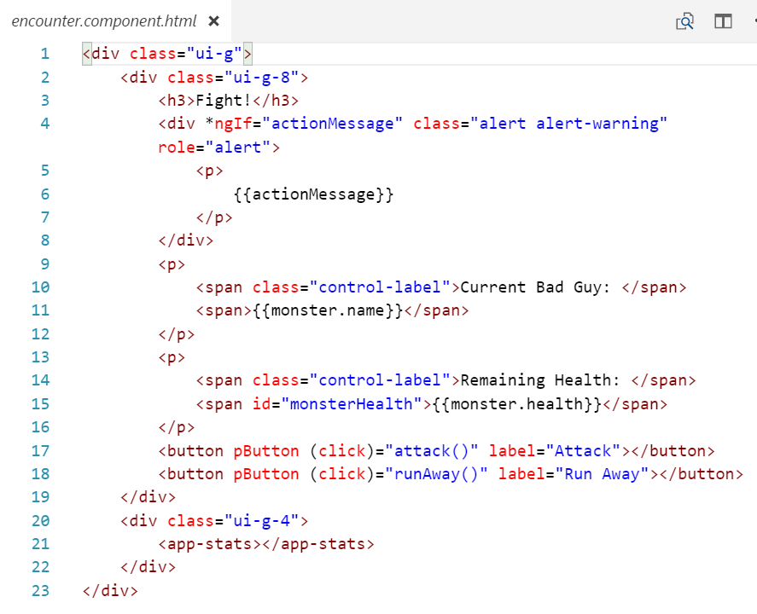

Slide 26
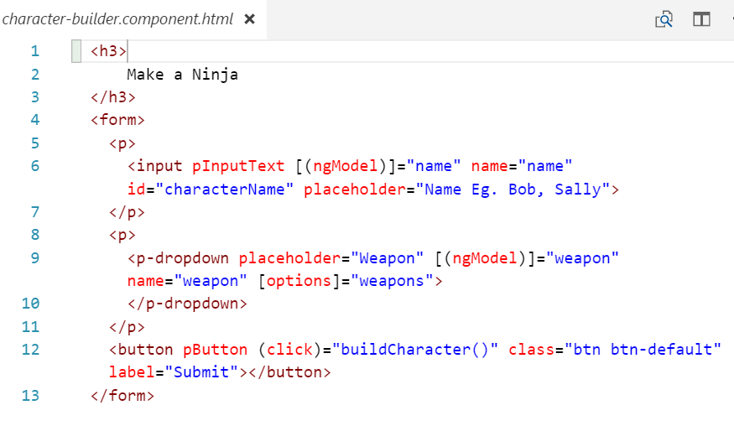

Slide 27
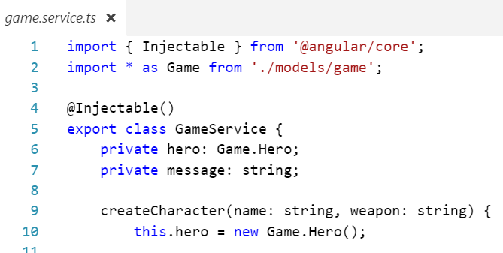

Slide 28
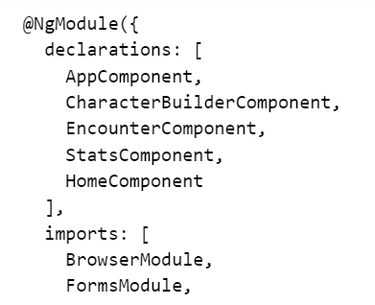
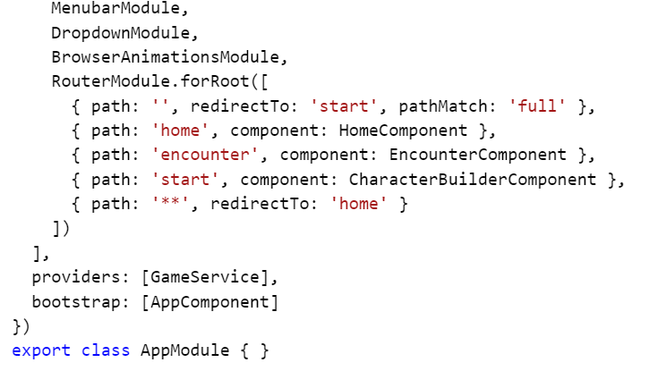

Slide 29

Tooling

Slide 30
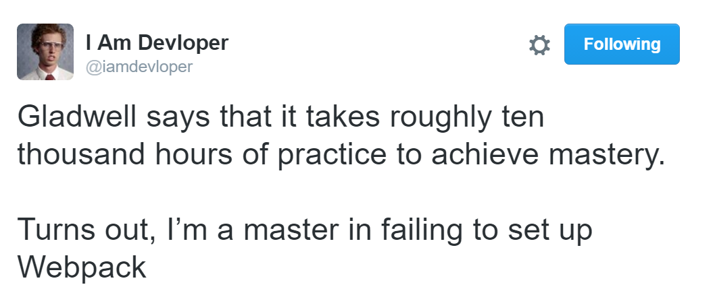
Webpack
Notes:
Version 2, really nice….

Slide 31

Angular CLI
Notes:
CLI tools to easily setup and serve Angular applications

Slide 32
Demos

